Slide 1
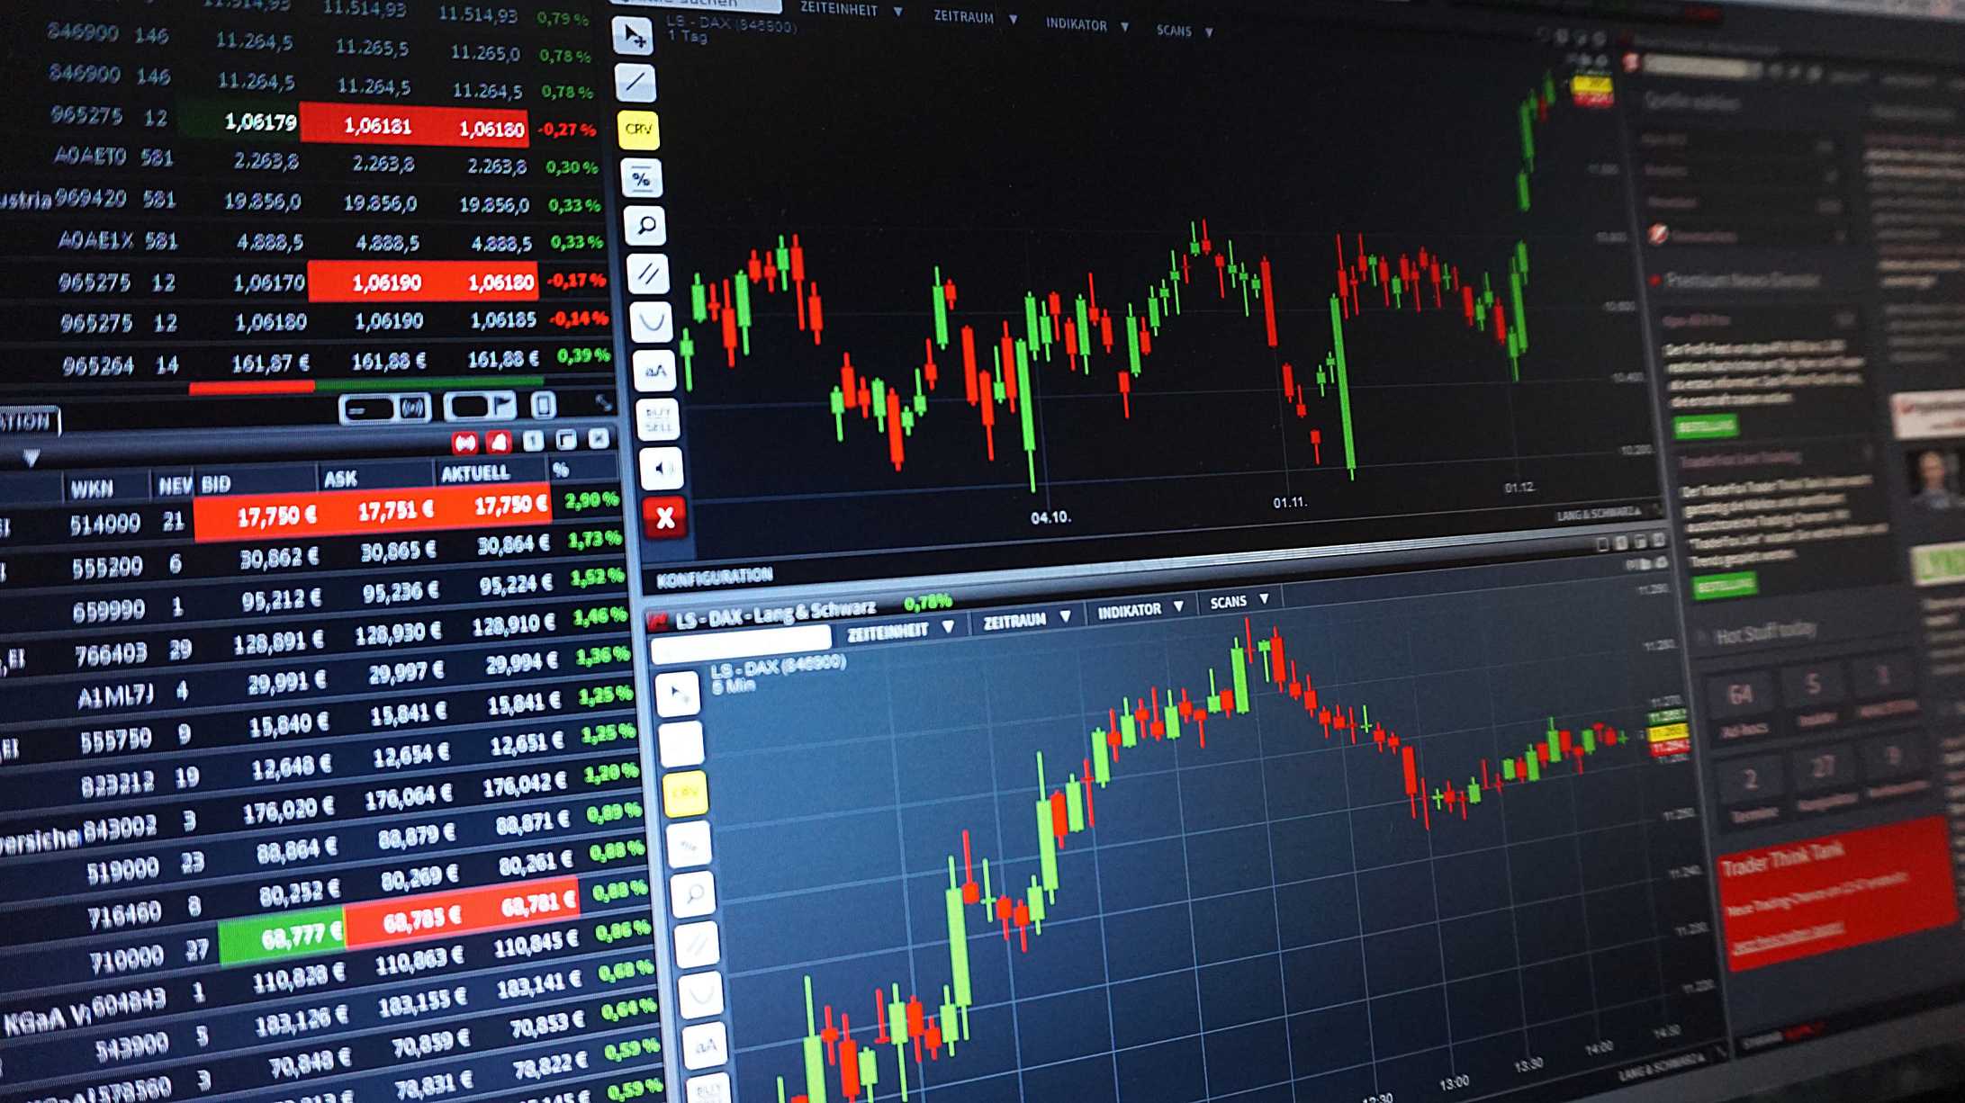
StockMarket Analysis
~By Ankita Sarkar

Slide 2


What We Will Talk About
Introduction
2.Objective Of The Analysis
3.Conclusion

Slide 3
Introduction
This project focuses on building an interactive Power BI dashboard to analyze stock performance over time. The dashboard provides key insights by comparing selected month's trading volume with the previous month. Using advanced DAX measures and calculated tables, it dynamically displays the difference between periods and visualizes trends. Designed for investors and analysts, this tool enables efficient decision-making by highlighting top-performing and underperforming stocks, making it an essential resource for financial analysis.
N
www.reallygreatsite.com

Slide 4

Tools Used For Analysis
Microsoft Excel: Used for data cleaning, manipulation, and preliminary analysis.
Power Query: Leveraged for advanced data transformation and automation of workflows.
Power BI: Created interactive dashboards and visualizations to present insights effectively.

Slide 5
Month-wise Stock Market Analysis Summary
Current Month Volume:
602.81M, a decrease of -71.44% compared to the previous month (2110.84M).
Indicates a sharp decline in trading activity or stock demand.
Volume by Month:
Steady decline from March to May after peaking in March (~3bn).
Suggests reduced market participation or lower stock performance over time.
Opening and Closing Prices :
Peaks observed in March and April.
Average opening price: 215.25, and average closing price: 215.38, showing stability.
Highs and Lows :
Maximum high price: 373.83 (likely in March).
Minimum low price: 88.86, reflecting market volatility between months.
Summary:
The analysis highlights a significant decline in market activity post-March, with relatively stable stock price averages. The reduced trading volume in May could be a result of market corrections or external economic factors.

Slide 6
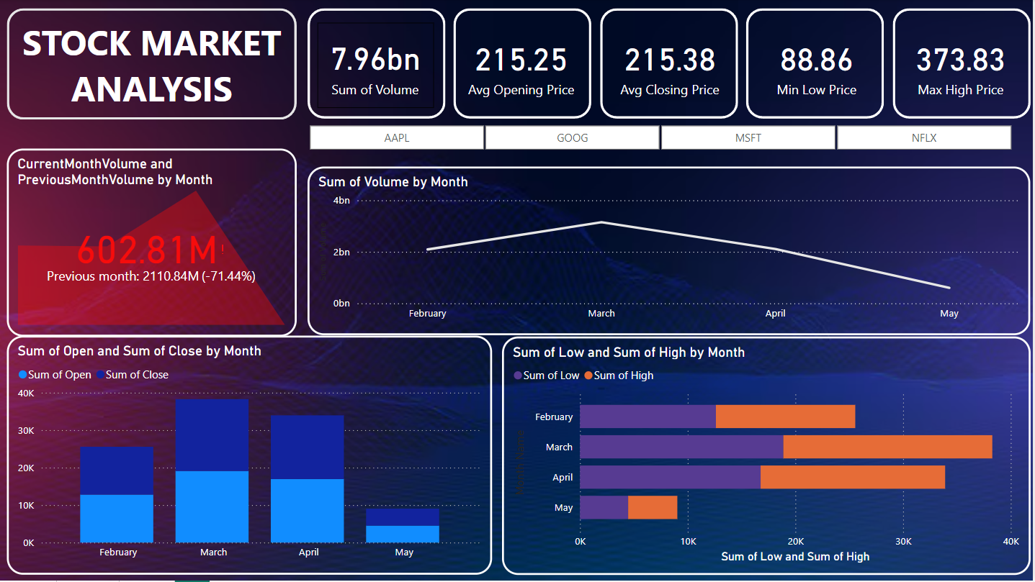

Slide 7
Week-wise Stock Market Analysis
Sum of Volume :
Week 1 to Week 3: Increased steadily, peaking in Week 3 (~+33% from Week 2).
Week 4 and Week 5: Significant decline (~-50% from Week 3 to Week 5).
Sum of Open and Close Prices :
Week 1 to Week 4: Gradual increase (~+50% from Week 1 to Week 4).
Week 5: Drop (~-33% from Week 4).
Closing prices consistently exceeded opening prices across weeks.
Sum of Highs and Lows :
Week 3 and Week 4: Saw the highest highs (~+40% higher than Week 1).
Week 5: Decline in both highs and lows (~-60% from Week 4).
Summary
The market peaked in Week 3, with trading volume and price activity increasing by over 30% from earlier weeks. However, a sharp decline of 50-60% was observed in Week 4 and Week 5 across volume, highs, and lows. Closing prices consistently outperformed opening prices, indicating positive momentum in the initial weeks, followed by reduced participation and market correction in the later weeks.

Slide 8
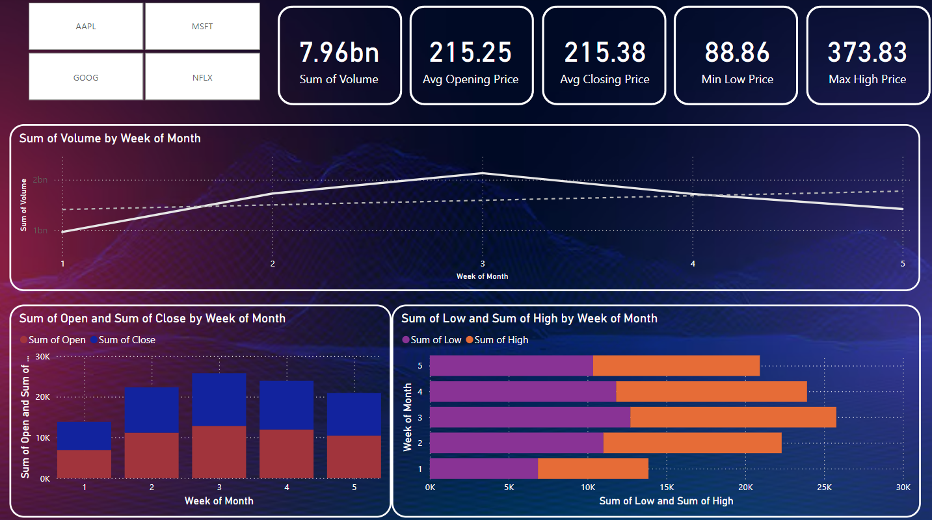

Slide 9
Daily Stock Market Analysis
1. Daily % Change by Ticker:
NFLX: Highest positive daily change (~+0.004 or 0.4%).
AAPL: Smallest daily change (~+0.001 or 0.1%).
GOOG and MSFT: Moderate increases (~+0.002 or 0.2%).
2. Sum of Volume by Day:
Steady increase from Monday to Wednesday (~+33%), peaking on Wednesday (~1.8bn).
Decline on Thursday and Friday (~-16% from Wednesday).
3. Sum of Open and Close by Day:
Tuesday: The highest difference between opening and closing prices (~+10%).
Thursday and Friday: Slightly lower levels, indicating reduced trading activity.
4. Sum of High and Low by Day:
Wednesday and Thursday: Saw the highest highs (~+20% compared to Monday).
Friday: Declined significantly (~-25% from Thursday).
Summary :
NFLX showed the highest daily percentage change, while trading volume and price activity peaked mid-week (Tuesday and Wednesday) before declining toward Friday. Closing prices consistently exceeded opening prices, indicating positive sentiment early in the week, followed by reduced activity by the week's end.

Slide 10
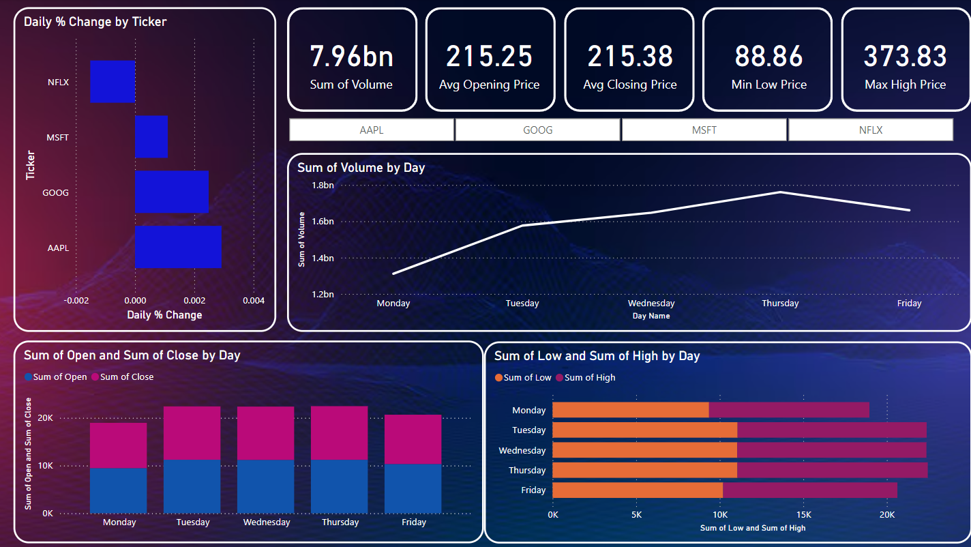

Slide 11
Decisions to Take
Focus on mid-week trading for better opportunities, as volumes and positive sentiment peak during these days.
Plan investments around Week 3 of the month, avoiding Weeks 4 and 5 when market activity slows.
Monitor stocks like NFLX, which demonstrate strong daily percentage changes, for short-term gains.

Slide 12
Conclusion
The Stock Performance Analysis Dashboard successfully provides a comprehensive view of stock trends and performance metrics, empowering users to make data-driven decisions. By leveraging Power BI's dynamic capabilities, it allows for seamless comparison of selected and previous months’ data, highlights key differences, and visualizes trends effectively. This project demonstrates the power of data visualization and analysis in understanding market behavior, offering a scalable solution for investors and analysts to monitor and evaluate stock performance efficiently.

Slide 13


Thank
You.
~ Ankita Sarkar
Ankita Sarkar
anki.cob9@gmail.com

